Slide 1

Interim Project 3 – Housing
Antoni Angelo Alfon
Jane Cheung

Slide 2
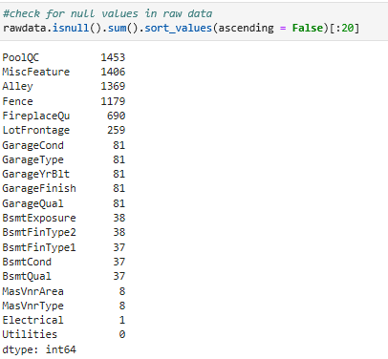
Exploratory Data Analysis
Raw Data = 1460 rows and 81 columns
Null Values
Sales Condition - Decided to target Normal Condition of Sales

Slide 3
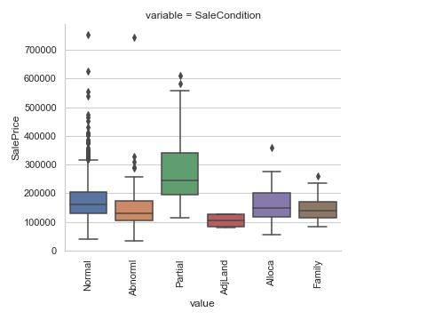
Sales Condition

Slide 4
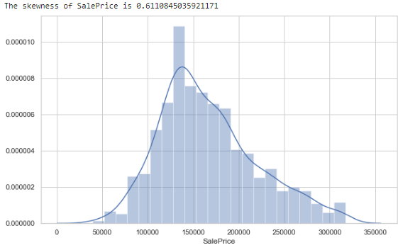
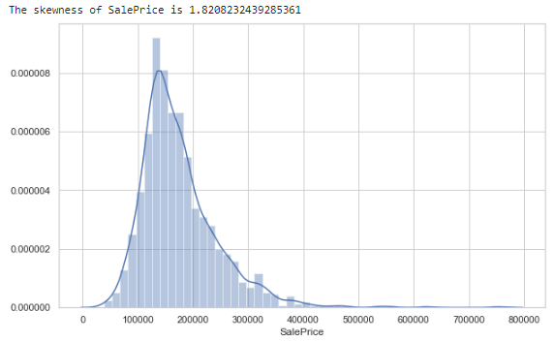
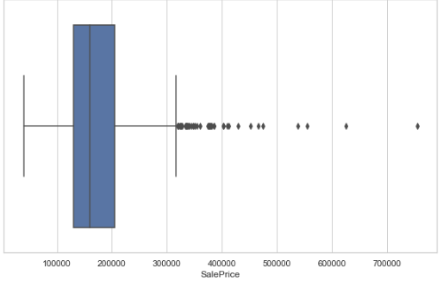
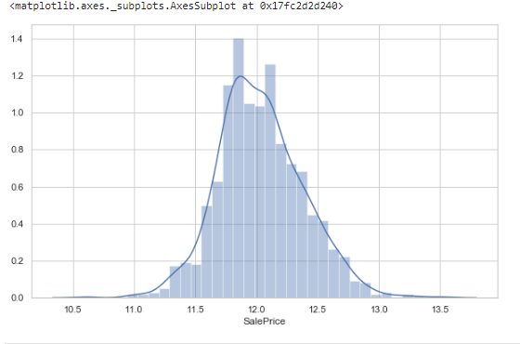
Exploratory Data Analysis
CLEAN DATA
Raw dataset = (1460 , 81) Dropped variables with too many null variables
Raw dataset = (1460 , 75) Dropped variables where the Sale Condition is not normal
Raw dataset = (1198 , 75) Replace remaining nulls with ‘N/A’ e.g. Garage Condition = n/a as there is no garage
Final dataset:
38 numeric and 38 categorical columns
APPROACH: Test regression with two options:
Option 1: Run linear regression by limiting dataset – remove all outliers i.e. > $317,500
Option 2: Run linear
regression with the
log-transformed
Sale Price
Label data ‘Sale Price’ does not follow a normal distribution

Slide 5
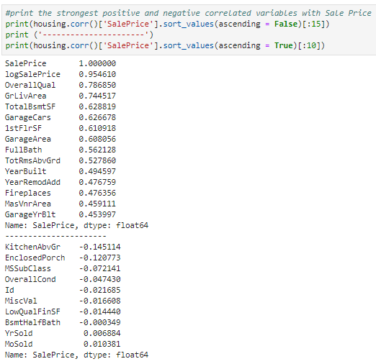
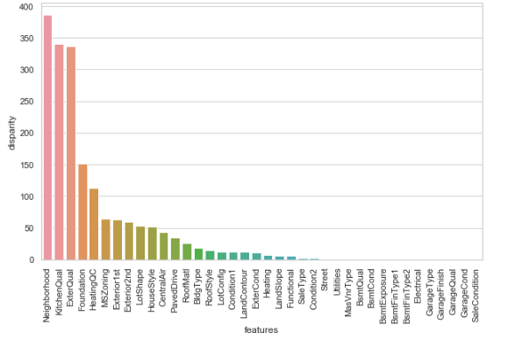
Numerical & Categorical Variables
Numeric variables
(correlation with Sale Price)
Categoric variables (disparity function based on ANOVA)

Slide 6
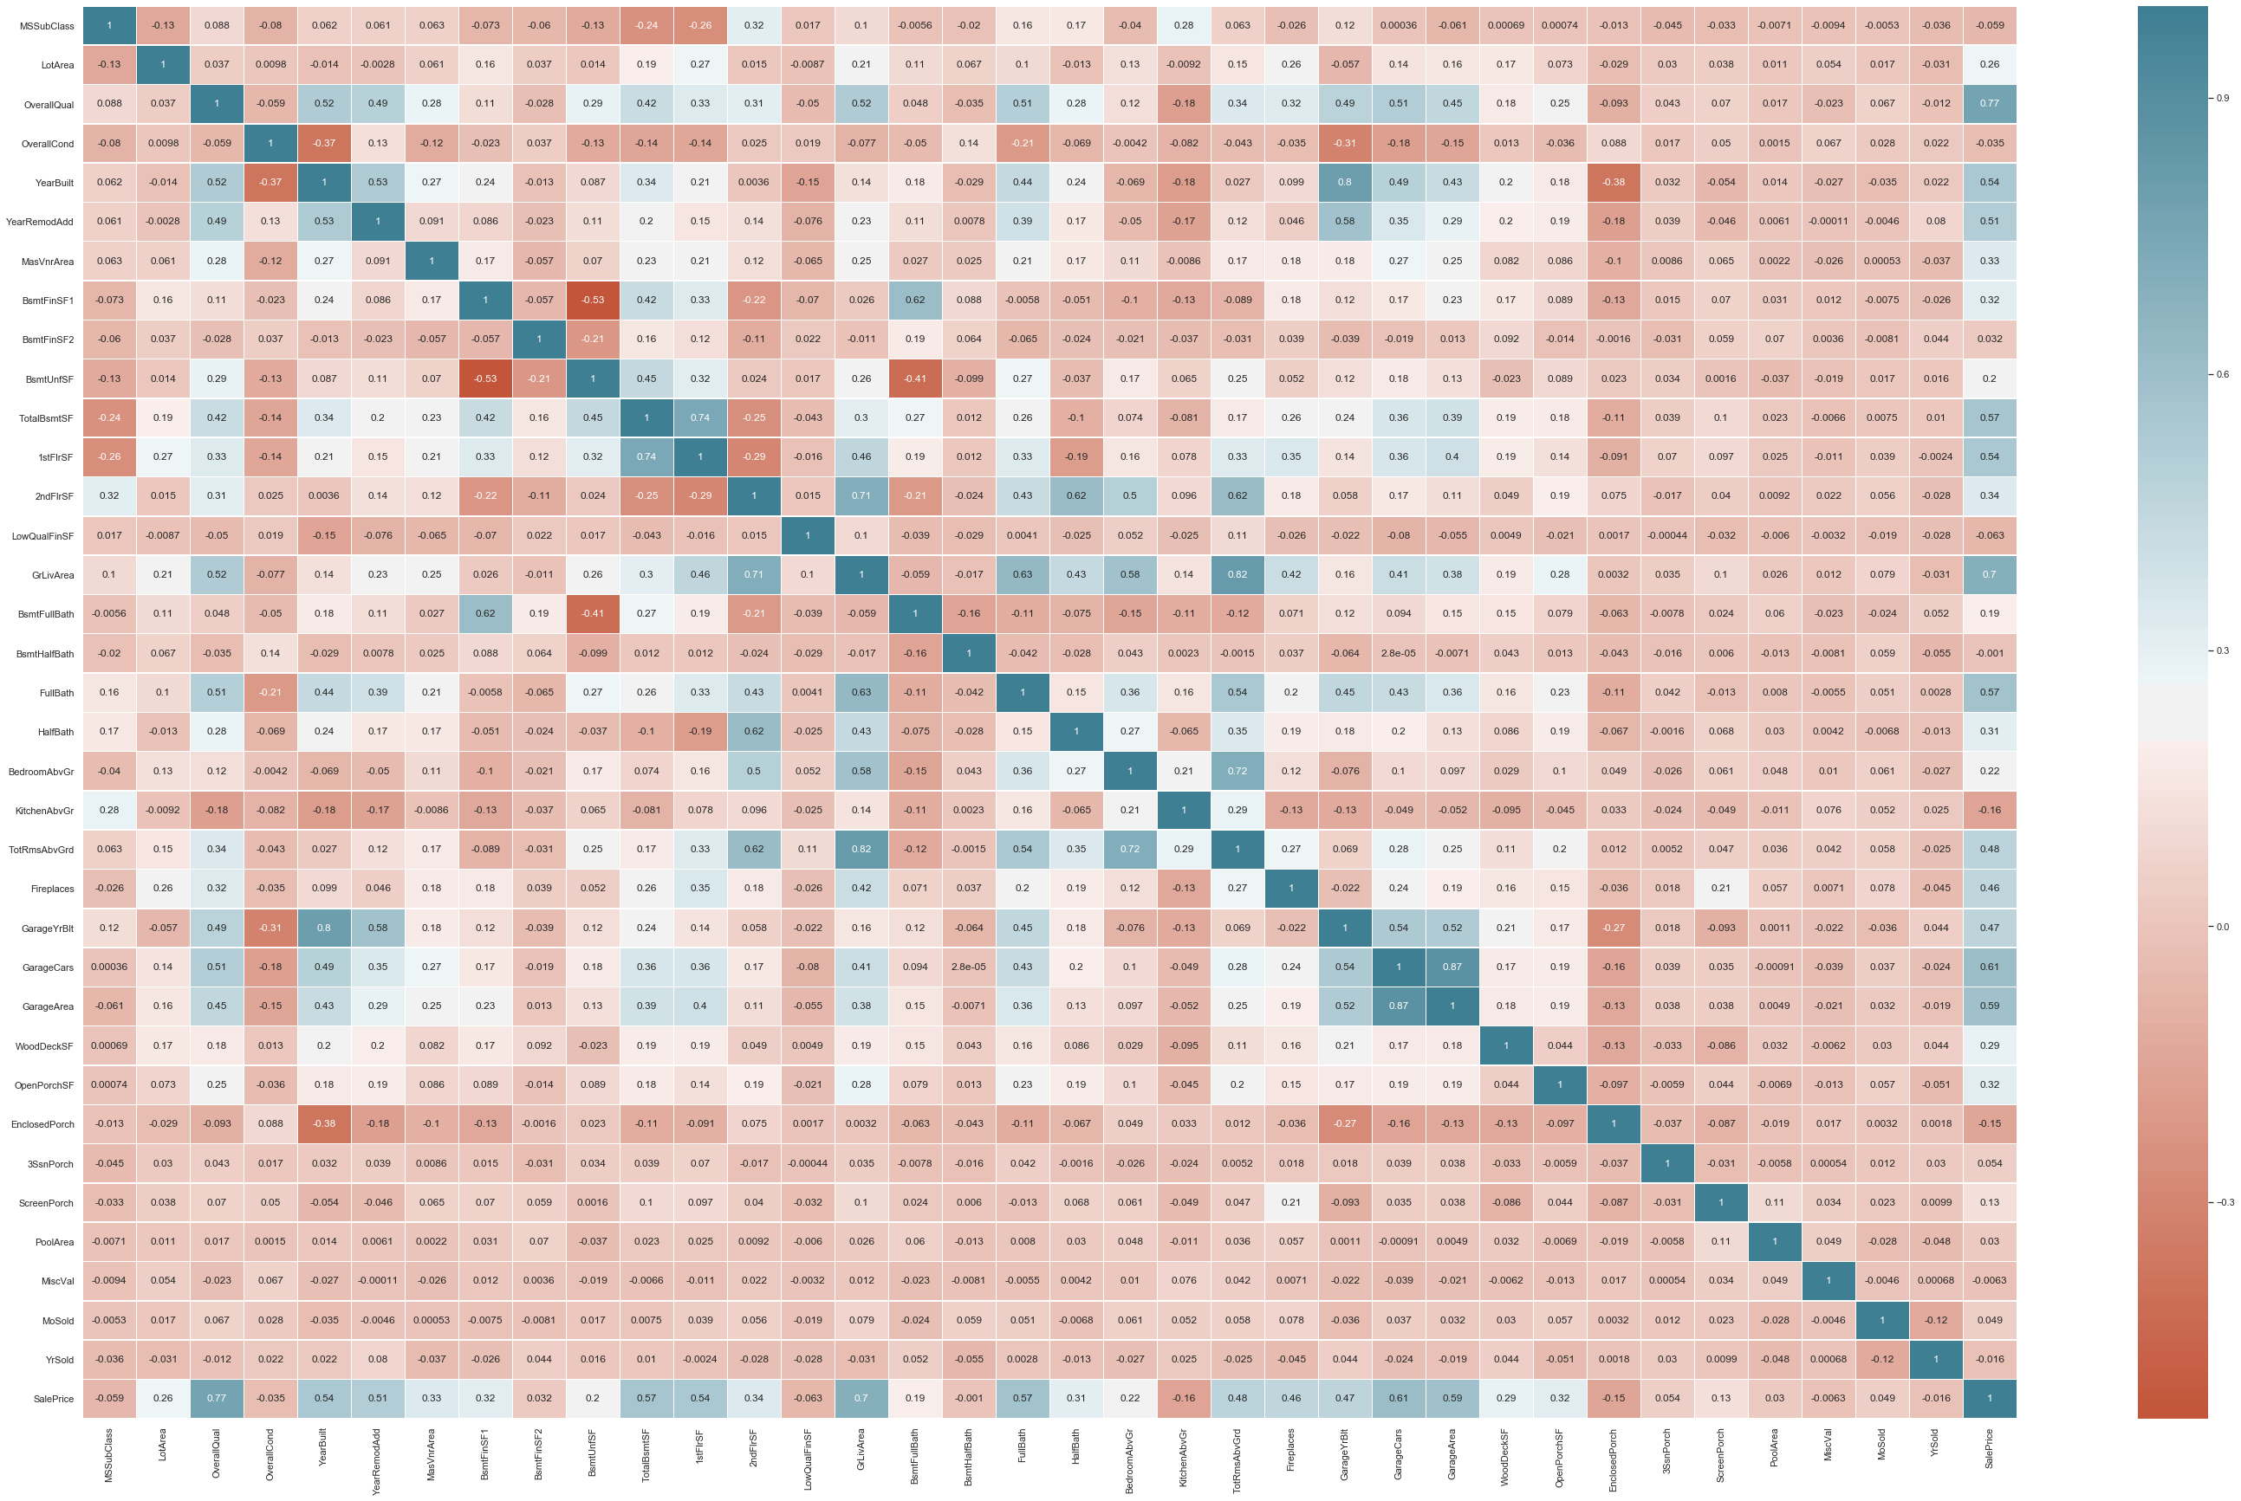

Slide 7
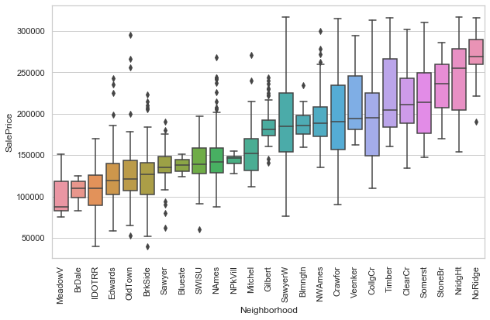
Sale Price vs Neighbourhood

Slide 8
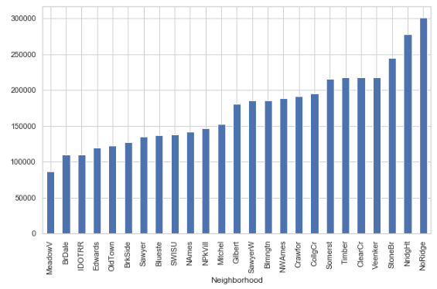
PREDICTOR VARIABLES
Picked one variable (in red) from each explanatory category – based on further analysis
Converted neighborhood into a dummy variable (based on median values)
Category | Variable | Description | Type
Location | Neighbourhood | Suburb (categorical) | Categorical - nominal
Quality | OverallQual | Overall material and finish of the house | Numerical – ordinal
Condition | KitchenQual ExterQual YearRemodAdd YearBuilt | Original construction data (year) | Numerical – discrete
Size | GrLivArea TotalBsmtSF 1stFlrSF | Above grade (ground) living area square feet | Numerical - continuous
Garage | GarageCars GarageArea | Size of garage in square feet | Numerical - continuous
Bathrooms | FullBath | Full bathrooms above grade | Numerical – discrete
Number of rooms | TotRmsAbvGrd | Total rooms above grade (does not include bathrooms) | Numerical – discrete
Other | EnclosedPorch KitchenAbvGr
Low
Med
High

Slide 9
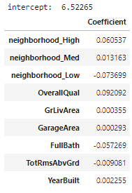
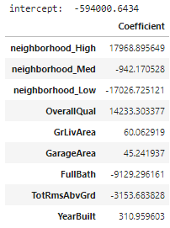

LINEAR REGRESSION RESULTS
Where Y = log-transformed Sale Price
Where Y = nominal Sale Price (ex. Outliers)
e.g.
being in a nice suburb can increase the Sale Price by 6.1%
each notch of overall quality adds 9.2% to the Sale Price
e.g.
being in a nice suburb can increase the Sale Price by $17.9k
each notch of overall quality adds $14.2k to the Sale Price
Odd that FullBath & TotRmsAbveGrd have
negative coefficients…
R-squared | 0.83932
Mean Absolute Error | 0.11506
Mean Squared Error | 0.02181
Root Mean Squared Error | 0.14767
R-squared | 0.78299
Mean Absolute Error | 18369.9
Mean Squared Error | 579373975
Root Mean Squared Error | 24070.19
< Dataset = (1198 , 75) >
< Dataset = (1150 , 75) >

Slide 10

Potential & further work?
Run regression used on scaled data
Use LASSO, RIDGE, and other regression methods
Test different combination of predictor variables and/or different ways to segment variables

Slide 11

Recommendation and Questions

